Slide 1
Wednesday, March 9 at 6:00 PM
Where to Park?
Using Python to Map Parking Regulations Signs to the Curb in Near Real-Time
Presented by: Jada Grandchamps, Graduate Student, Geography, Hunter College, CUNY
Visit open-data.nyc to view the full program.
Notes:
Title Slide: Put this at the front of your presentation

Slide 2
Speaking order
This slide will be hidden—its just for us
Maddalena will introduce the project, and hand off to David
David will discuss parking regulations sign maintenance and management, and hand off to Matt
Matt will discuss the need for this project, and will show some examples of issues from other maps, and hand off to Jada
Jada will discuss her work on the project

Slide 3





Meet The Team
Maddalena Romano
David Arcement
Matthew Garcia
Suzanne
Zopf
Jada Grandchamps
Department of Geography
Analytics and Performance
Management
Traffic Control and Engineering
Parking Administration
Information Technology
2
Notes:
Sample Slide

Slide 4
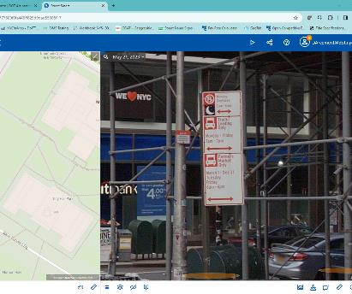
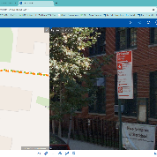
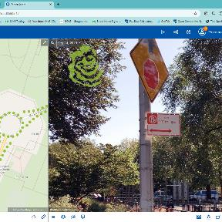
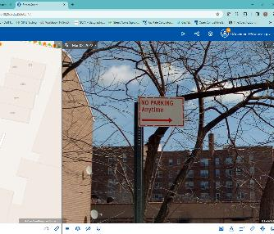
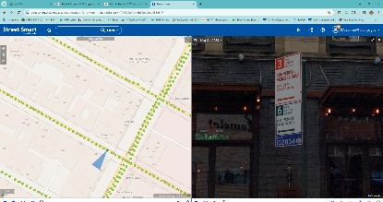
Background
New York City Dept. of Transportation (NYC DOT) is responsible for installing most of the signage in the five boroughs of NYC.
Notes:
Sample Slide

Slide 5



Issues with Other Maps
Coverage
Our goal:
A map of all NYC parking regulations that updates in near real time
Update Frequency
Categories
Notes:
Sample Slide

Slide 6





Scope
Datasets
Software
Pavement Edge
Pedestrian Ramps
Parking Regulations
Notes:
Sample Slide

Slide 7
QGIS Component
Notes:
Sample Slide

Slide 8
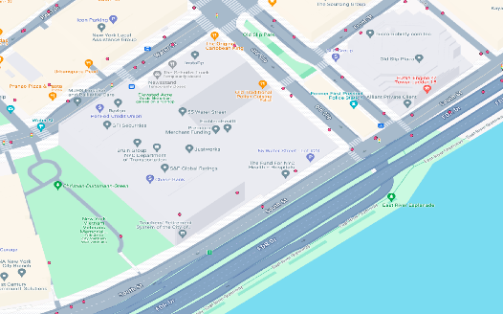
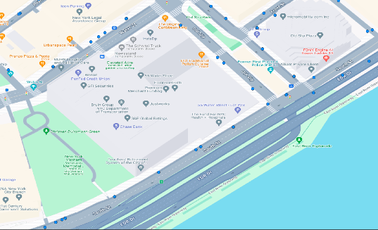
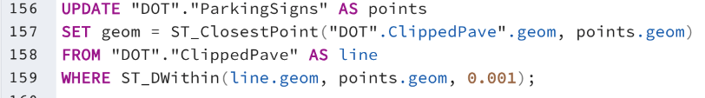
Methods: Snap Points
Notes:
Sample Slide

Slide 9
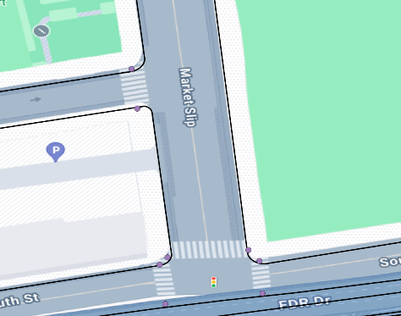
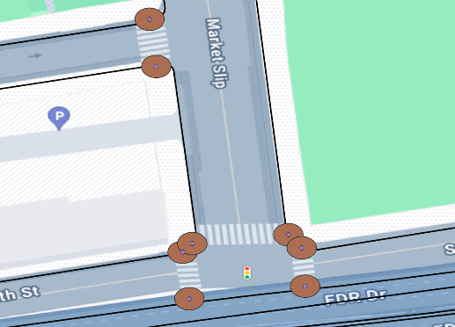
Methods: Buffering
Notes:
Sample Slide

Slide 10
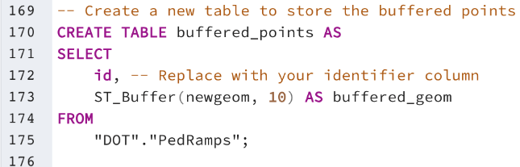
Methods: Buffering
Notes:
Sample Slide

Slide 11
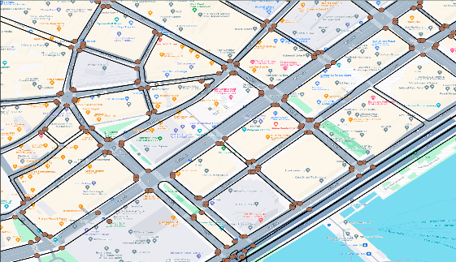
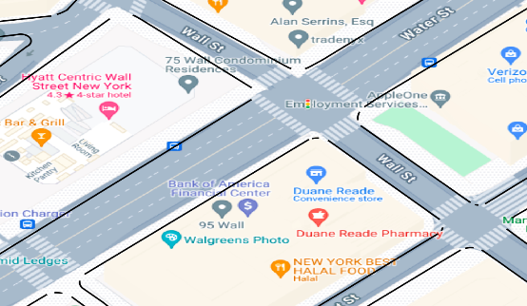
Methods: Clip
Notes:
Sample Slide

Slide 12
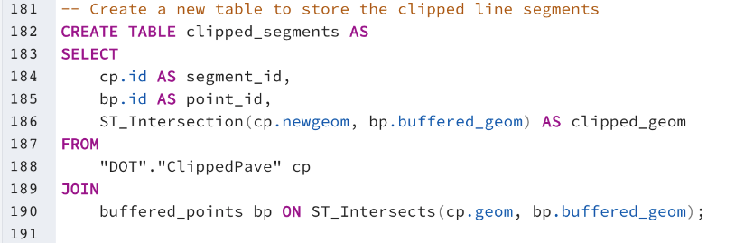
Methods: Clip
Notes:
Sample Slide

Slide 13
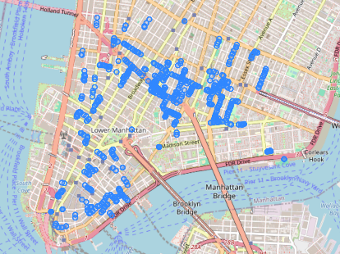
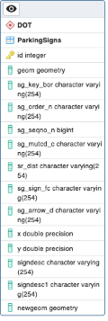
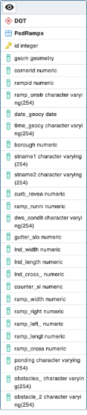
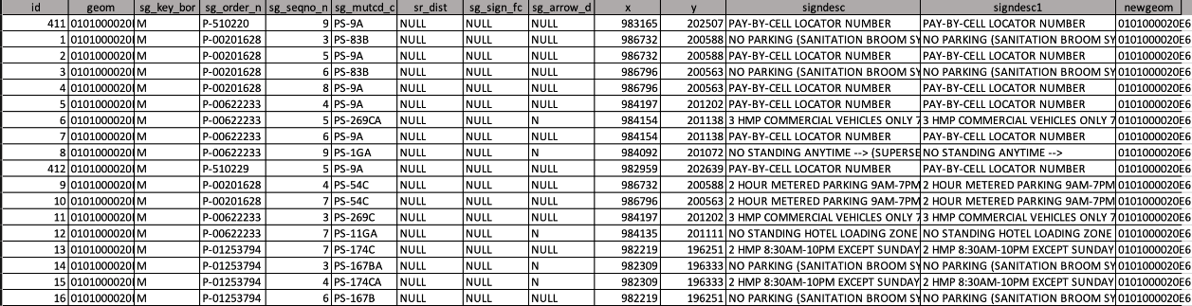
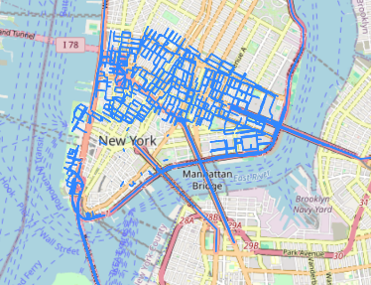
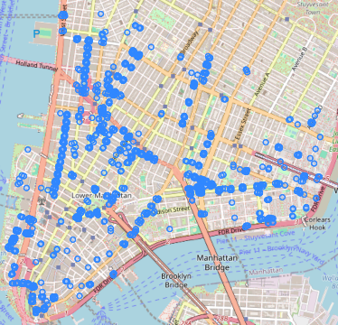
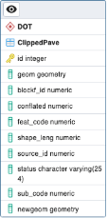
Variables and Assumptions
Parking Signs
Pavement Edge
Pedestrian Ramps
Notes:
Sample Slide

Slide 14
SQL Component
Notes:
Sample Slide

Slide 15
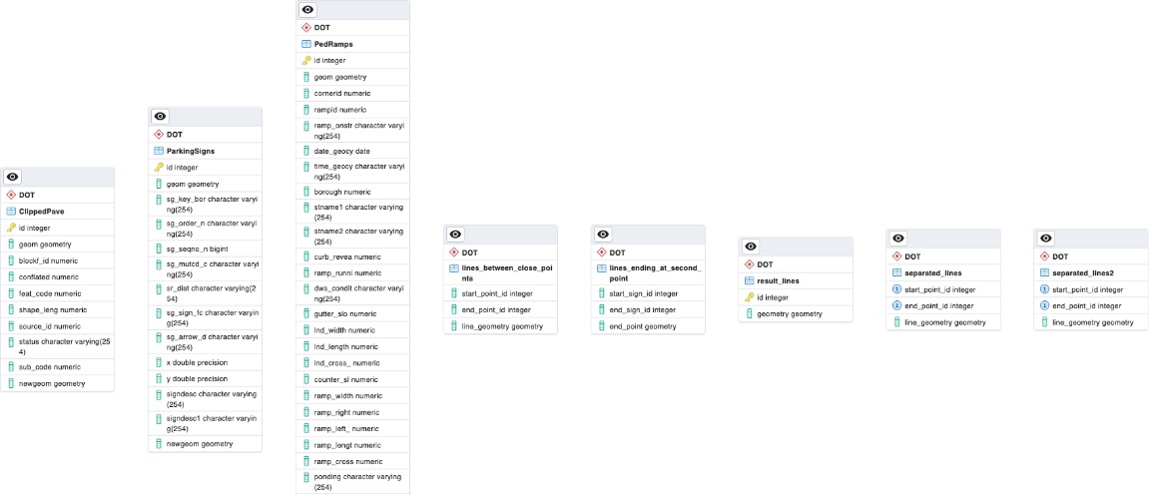
Database Analysis
Notes:
Sample Slide

Slide 16
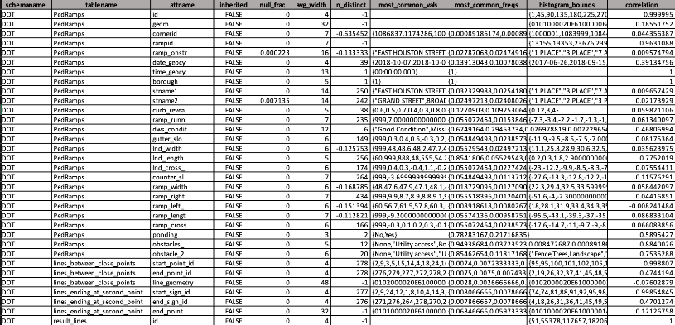
Database Analysis
Notes:
Sample Slide

Slide 17
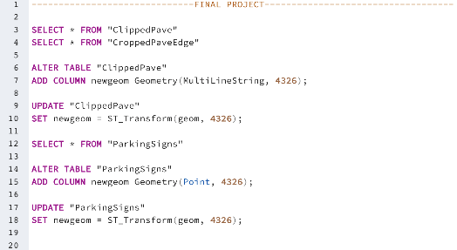
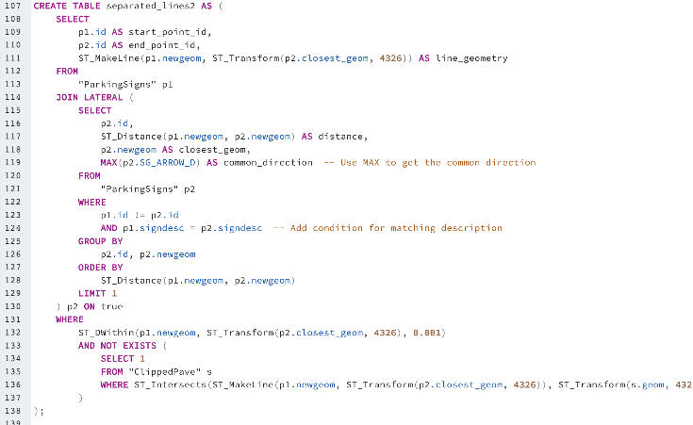
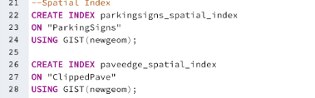
Methods: Connections
- Reprojected Geometry Column from ESPG:2263 to 4326
- Created Spatial Index to shorter query run time
- Joined Pavement Edge and Parking Regulations using new geometry column
- Ran a query that took the common direction of one point on the same line segment and connected the points in that same direction
Notes:
Sample Slide

Slide 18
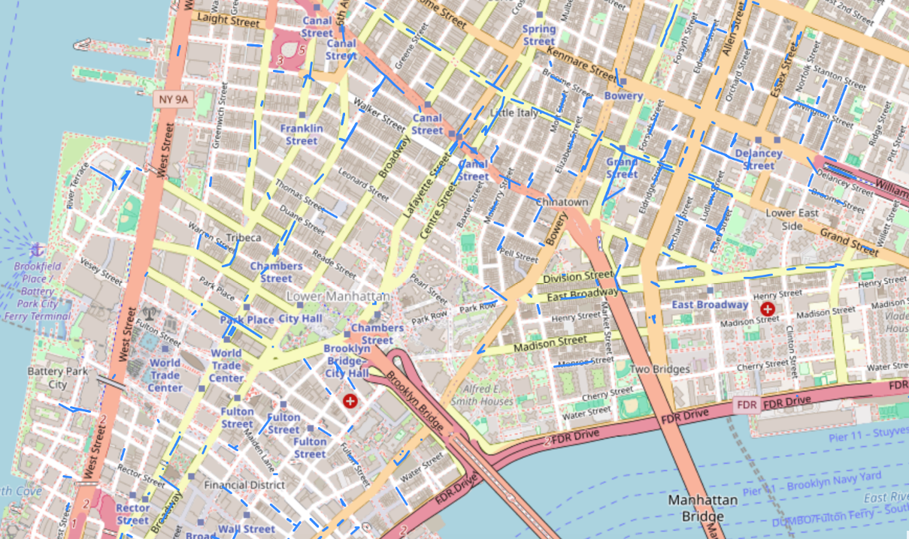




Results
Lines between signs represent the length of parking/no parking areas on streets.
Notes:
Sample Slide

Slide 19
Python Component
Notes:
Sample Slide

Slide 20
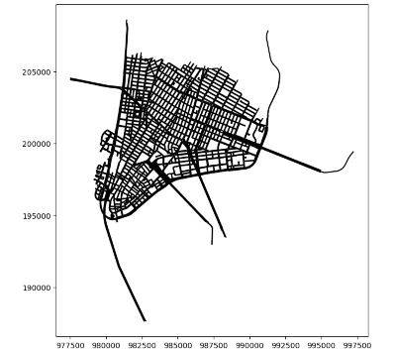
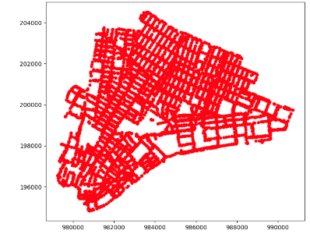
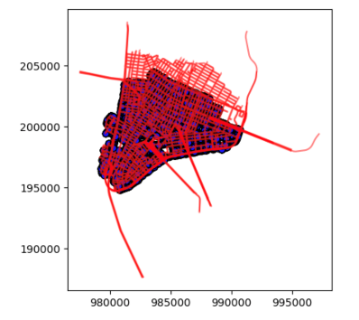
Datasets
Pavement Edge
Parking Signs
Parking Signs overlayed on Pavement Edge
Notes:
Sample Slide

Slide 21
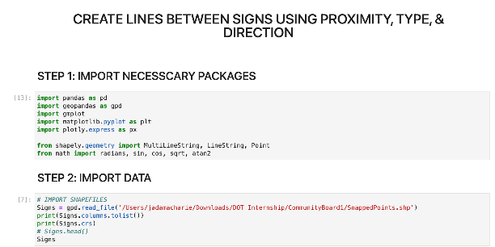
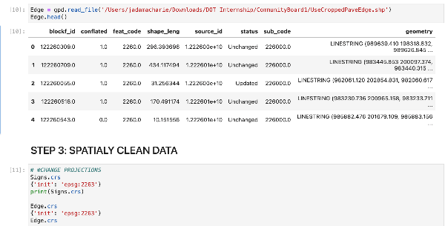
Method: Initial Steps
Notes:
Sample Slide

Slide 22
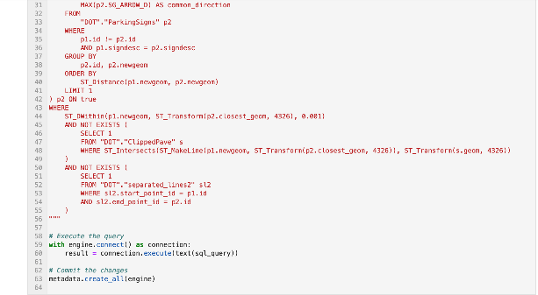
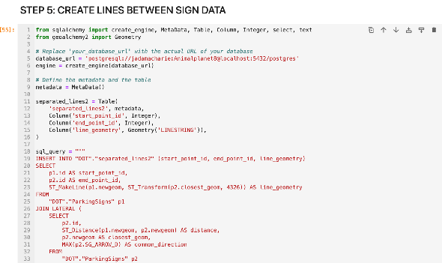
Method: Creating No Parking/ Parking Lengths
Notes:
Sample Slide

Slide 23
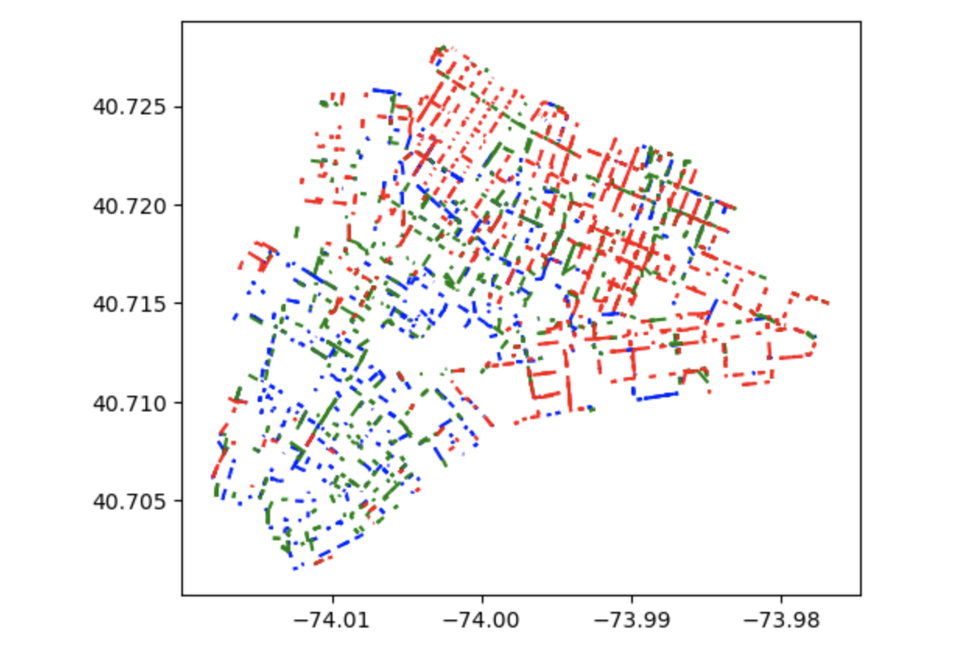
Results
Notes:
Sample Slide

Slide 24
Discussion
Limitations:
Transforming my Parking Signs to line data types
Negating fire hydrants, Bus stops, loading docks, etc.
Some of the Pedestrian Ramps are not located on the corners of the streets
Creating lines between Parking Signs using Pavement Edge
Converting all Parking Signs to lines
Clipping Pavement Edge by Sign Points
Next Steps:
- Create web front-end application for data visualization
Notes:
Sample Slide

Slide 25
Thank you for participating in Open Data Week!
Join us at more events through Sunday, March 24. View the program at open-data.nyc.
jada.macharie96@myhunter.cuny.edu
https://github.com/Jada68/DOT-Parking-Regulations
QUESTIONS?
Notes:
End Slide: Put t

